Slide 1
2018 Investment Planning
Allocation plan for new purchase funds

Slide 2
Introduction
Reviewed 24 months of property sales data from all types of properties in NYC
Data consists of over 85,000 sales spanning from 2016-2017
Tested for variance between timing of sales (Q1-Q4)
Tested property sales for differences between:
Residential vs. Commercial purposed properties
Average age of properties (below average vs. above average)

Slide 3
Considerations
Purchase parameters
Looked at property sales ranging from 1,000 to 5M to exclude outliers
Timing
Best quarter for purchasing overall
Also separated best quarter for residential vs. commercial
Age of property
Checking if age is a factor in sales price
Many records showed no build year so I set observations from 1900 on

Slide 4
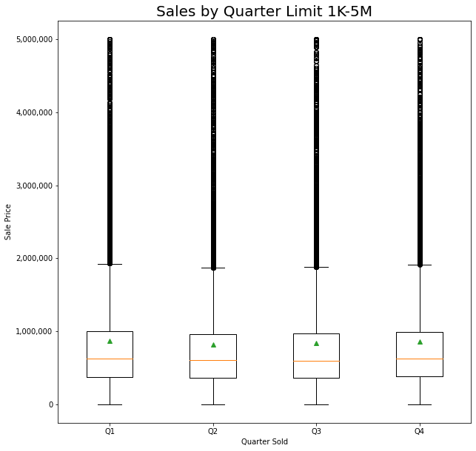
Timing
Best time to purchase any type of new property is between Q2-Q3
Variance is small but significant seeing on average Q2-Q3 costing anywhere between 18,000-75,000 less on average

Slide 5
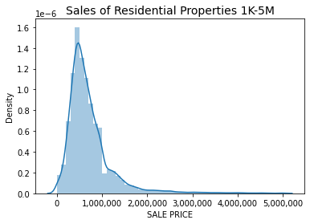
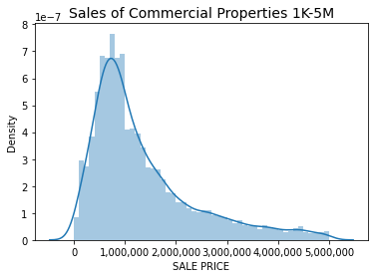
Residential vs. Commercial
Residential properties are selling on average 600-650k less than commercial properties

Slide 6
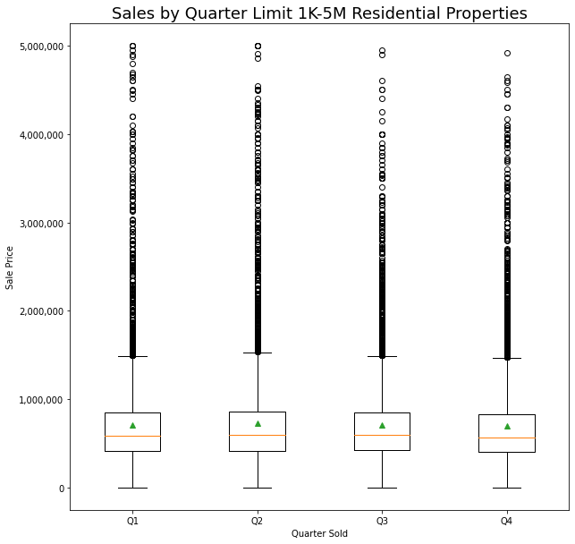
Residential
Small variance between quarters
Q2 being the highest and Q4 the lowest
Q4 ranging 11-57k less than Q2 on average

Slide 7
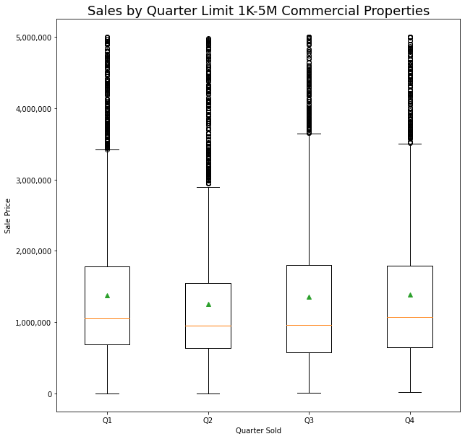
Commercial
Q3 is the highest and Q2 the lowest
Q2 ranging between 27-198k less than any other quarter on average

Slide 8
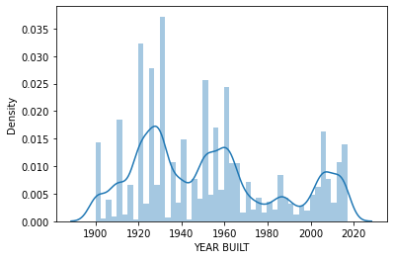
Age of Properties
Many records exist with no recorded building date
Excluded those records by only testing properties built since year 1900
Average year built for sold properties is 1952 so comparison is for properties built before or after 1952
New properties are being sold on average less than older properties by 24-51k

Slide 9
Recommendations
Purchase of any property regardless of type should primarily occur in Q2
Exception to this is residential property that is best to purchase during Q4
Residential property is much less expensive to acquire, but more research is required to determine profitability for leasing
Older properties are more expensive on average so it will be better to focus on purchasing newer properties

